Slide 1
OneNote

Slide 2
A few ground rules
You can’t learn a technology if you don’t play with it.
All technology is made by man – expect glitches from time to time.
Don’t be afraid to break it.

Slide 3
Why the cape? Also – what is OneNote?
OneNote is a universal note taking platform
  Accessible from almost every device
  Almost every type of content
  Almost every type of input (handwriting, type, audio)
  Literally – a blank notebook for you to use or share
Find a single use for OneNote – then expand.
Notes:
I start this class by wearing a purple onenote cape. ☺
This is a perfect example of the learning tools add-on, which we will cover later.
The blank notebook may be the scariest part of OneNote – no guidelines
My recommendation is to find one idea for use that really sticks. For most people, you’ll probably find a perfect use personally.

Slide 4

Ways to Access
Office OneNote
  most features but must be installed first.
  Customizable (ex: https://getonetastic.com/)
  Most of our time today will be spent here.
OneNote Online
  https://onenote.com
  Available with any browser
OneNote App
  Quick mobile access (phone, Chromebook, iPad)

Slide 5
Lab 1: Setting up OneNote (first time user)
Hardest part about OneNote is getting started.
After this lab, you will have:
  Signed onto OneNote Online with your work account (same account that you use to log into the computer or to check email).
  Created a new notebook in the cloud
  Opened that notebook in Office OneNote
Tip for labs: Drag PowerPoint all of the way to the left side of the screen to view two applications at once.

Slide 6

Lab 1: Setting up OneNote (first time user)
Launch Chrome – wait a minute until the OneNote page opens.
In the top left corner, select the OneNote square grid icon (not the Chrome Apps square grid icon) and then choose OneNote Online.
Select: Sign in with a work or school account and enter your email address. Finish signing into OneNote Online.
Select Teacher. Your notebook will be created. Once created, minimize Chrome.
Open Office OneNote – Select sign in – close the Sign in (use your Microsoft account) prompt.
In top left, choose My Notebook – Open Other Notebooks – select the FIRSTNAME @ School Notebook
Select File. Under the Settings button for My Notebook, choose close.
Notes:
This lab is designed for an O365 environment using Office Onenote.

Slide 7
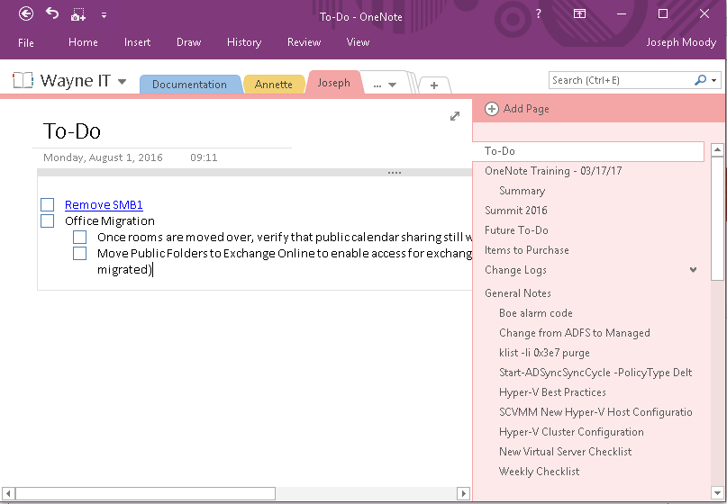
Notebooks, Sections, and Pages
Notes:
You may wish to create multiple notebooks. For example, you might create a personal notebook to share with family and a work notebook for school.
Sections can be password protected – right click on a section to apply a password
Pages can be grouped together (subpages). Drag a page to the left to subpage it.

Slide 8
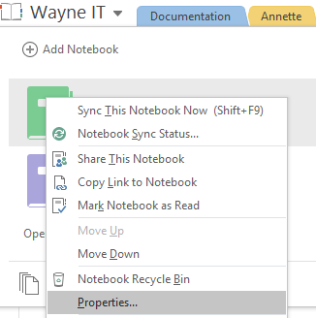
Checking your notebook location
Right click the notebook – properties – location

Slide 9
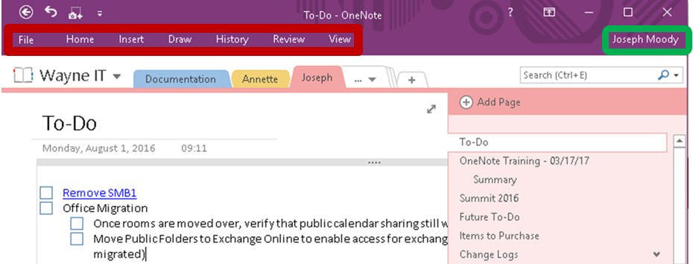
Ribbon and your account
Single click on any button in the red square – will open the ribbon once
Double click (or tiny pushpin on far right) – will keep the ribbon open
Click on your name (top right) to see account information.

Slide 10
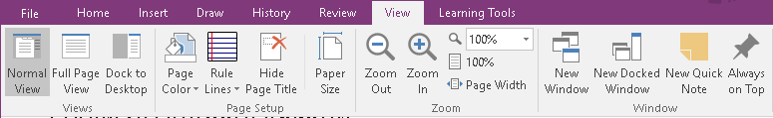
Different Views
Full Page View: great for hand drawing and brain storming.
Dock to Desktop: gives you a quick place to jot down notes throughout the day. Sticky notes on steroids.
Rule Lines/Grid Lines: awesome for writing and math.

Slide 11
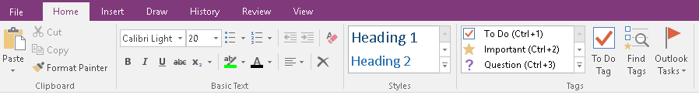
Tags, Reminders, Outlook Tasks
Tags are for filtering and organization.
  Definition tags can be used to quickly create a review sheet.
  Question tags can let you see what your students don’t understand.
Outlook Tasks links OneNote to email reminders.
  These are stored under Tasks in Outlook
  Always viewable – In Office Outlook, right click on Tasks – dock the peek

Slide 12
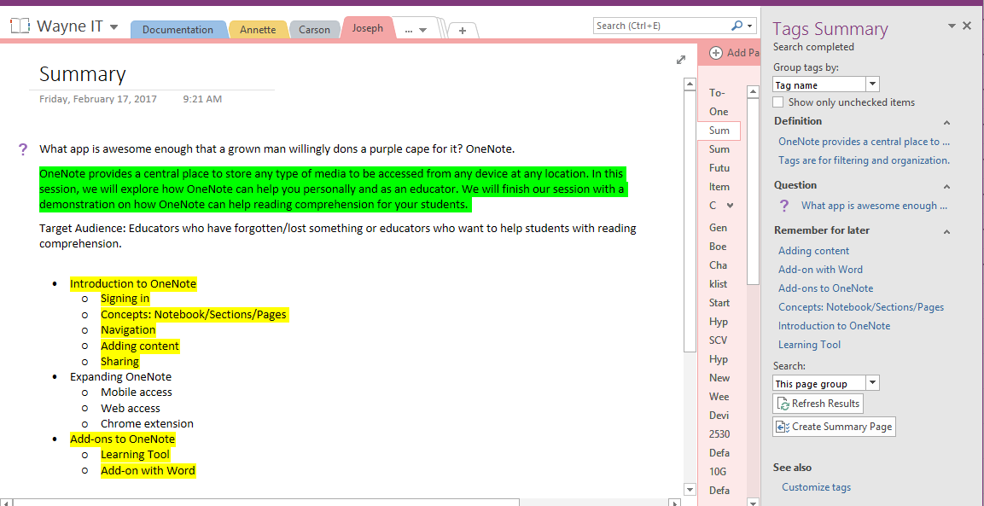
Tags Galore! AKA – the Find Tags button

Slide 13
Lab 2.1 Groceries and Recipes
Create a new section and name it: Groceries and Recipes
Title your page: Groceries
Add some grocery items.
Tag the items with a To Do Tag (highlight items – Select Tag as To do)
You should now have several items listed with a blank checkbox (To do tag) next to them.
Open the Find Tags tool. This should open a Tags Summary window.
Select Show only unchecked items. Change Search from This Section to This Page Group
Check one item under the Tags Summary window – it should be checked off your list now.
Select Create Summary Page to create a new page of only things that are unchecked.

Slide 14

Lab 2.2 Groceries and Recipes
Open Chrome – navigate to budgetbytes.com
Open any recipe that catches your eye
Select the Clip to OneNote extension (OneNote Icon in top right of Chrome)
Sign in with your work/school account if prompted.
Play with the different styles (full page, region recipe/article)
  - it should detect the page as a recipe. Indicated by #RECIPE near the top of the clip.
Under Location, choose your Groceries and Recipes section and select clip
Head back to OneNote – your recipe should then appear.

Slide 15
Searching
Everything in OneNote is searchable!
  By content
  By author
  By date
To copy text from a picture, right click
  When in doubt, just right click anyways
  Great for business cards, recipes, and important documents.

Slide 16
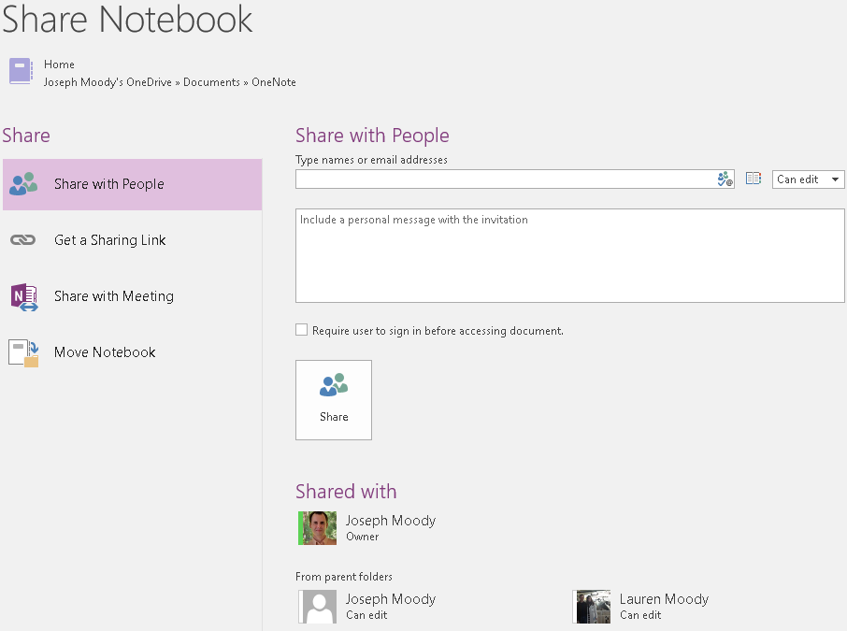
Sharing
File – Share
Can be shared to anyone (inside or outside school system)
A few examples:
  One notebook per class shared with your students.
  One notebook shared with your team or at your school.
  One notebook shared personally.

Slide 17
Learning Tools – OneNote Add-In
Enhanced dictation | Improves authoring text
Focus mode | Sustains attention and improves reading speed
Immersive reading | Improves comprehension and sustains attention
Font spacing and short lines | Improve reading speed by addressing "visual crowding"
Parts of speech | Supports instruction and improves writing quality
Syllabification | Improves word recognition
Comprehension mode | Improves comprehension by an average of 10%

Slide 18
Lab 3: Learning Tools
Select a page with some text on it.
Choose Learning Tools – Immersive reader
Adjust the spacing and text size
Enable Syl.la.bles mode
Press the Play button (if we had speakers, we would hear each word being read as it is highlighted).

Slide 19
Where to go from here?
Download the OneNote app to your phone and use it the next time that you buy groceries.
Plan a vacation with OneNote and store your ideas/confirmations in it.
Create a notebook for your team and share it. Use it to store resources, lessons, tips, etc.
Explore the Resources section under your @ School notebook (particularly the OneNote Class notebook link)
Learn about Class Notebooks at http://onenote.com/classnotebook

Slide 20
Additional Resources
https://blogs.office.com/onenote/education/
http://onenoteforteachers.com
http://www.thomasmaurer.ch/2014/02/this-is-why-onenote-is-awesome/
https://support.office.com/en-us/article/eBook-OneNote-2016-Tips-Tricks-4e08cf8b-dc37-4229-bdef-1f580220b6f5?ui=en-US&rs=en-US&ad=US

Slide 21
Applications that we used
OneNote Online: https://www.onenote.com/hrd
WebClipper for Chrome: https://www.onenote.com/clipper
Learning Tools: http://www.onenote.com/learningtools

