Slide 1
Security Essentials
Everything you didn’t want to know and more.
Notes:
These notes are designed for staff to use at work or at home. Some slides have been made generic to protect information.

Slide 2
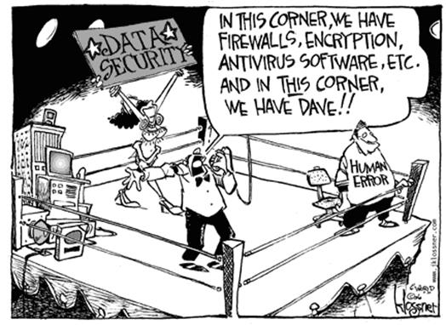
Why is security important?
A single compromised account can affect everyone else.
  05/17/17 Google Docs
  WannaCry ransomware
Notes:
If you can highlight a specific incident that had a direct impact on your environment, list it here.
WannaCry’s exploit not only highlights how a single action by a user can affect (and infect) everyone else. It also makes a strong point for keeping itmes up to date.

Slide 3
Why is your account important?
Your account is an extension of you.
  People trust items from your account.
  Safeguards can be bypassed with your account.
Some accounts are more important than others.
  Any account that can log into multiple services or reset logons.
    EX: An email account that can reset your online banking password is very important.
  Consider using multifactor authentication (MFA) for these accounts.
    password + phone code/authentication application
Notes:
Highlight an important account (like a personal email). I say something like, “If I wanted access to your bank account, I may only need access to your email account.”
MFA will sound scary to non-techs but most people already use it through online banking.

Slide 4
Locking and Signing Out
Locking your computer is a pause button.
  When leaving your computer temporarily, always lock it.
  Shortcut: Windows Key (Flag button) + L button
    Try this now.
Signing out is a stop button.
  When leaving your computer for the day, sign out.
  When using a public computer, sign out of the service and close any opened programs.
Notes:
This is the first slide that your staff can immediately use. A lot of your staff probably do not know what locking a computer is or how to do it. In the past, we encouraged staff to play harmless pranks on other staff members if they did not lock their computer. Things like swapping the left/right mouse buttons or taking a screenshot of the desktop – hiding all of the desktop files – and setting that screenshot as the desktop background.

Slide 5
Password Smackdown
  Tr0ub4dor&3
    vs
  correcthorsebatterystaple
    Which password is easier to remember?
    Which password is harder to guess?
Notes:
Feel free to use your best sports announcer voice on this slide. ☺

Slide 6
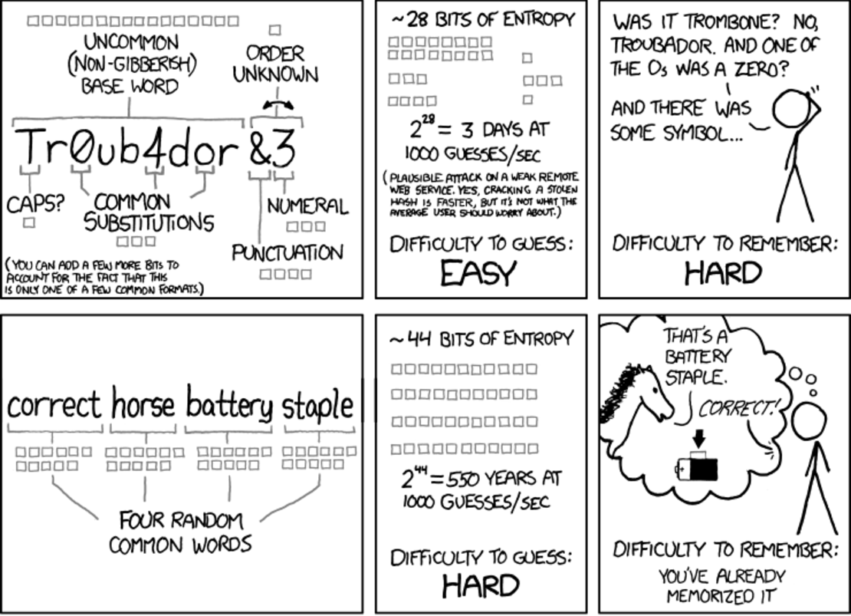
Through 20 years of effort, we’ve trained everyone to use passwords that are hard for humans to remember, but easy for computers to guess.
Notes:
Skip the explanation of entropy but show how much harder the passphrase is to guess.

Slide 7
Creating Strong Memorable Passwords
Length is better than complexity.
String random words together to create a passphrase.
Use unique passwords (especially for important accounts).
Keep your passwords private.
Notes:
I know that staff will not use unique passwords for every service that they use so I try to really stress unique passwords for important accounts.

Slide 8
Your Turn – Playing with Password Strength
Open a web browser and head to: https://howsecureismypassword.net/
Try out a few passwords that you have used in the past to see their password strength.
How much of a difference does length make to the strength of a password? Try a 12 character vs a 13 character password.
Notes:
Caution your staff not to go to strange websites and enter their passwords just because someone told them so.
Prepare for your staff to act like kids for 5 minutes as they try to figure out who has the hardest to guess password.

Slide 9
How to stop forgetting passwords.
Password managers remember account information for you.
These are secured through a single important password + something else (MFA).
Accessible across devices – pull up passwords on your phone.
Two good choices: Keepass and Lastpass
Notes:
If you want to deploy Keepass in your environment, use the command line: KeePass.exe /verysilent

Slide 10
Using a password manager
Notes:
If you want to show a password manager, do so here. Either put in a few screenshots or jump to a live demo. In our environment, I like to show how Keepass can be used to manage employee benefit passwords. Around Oct/Nov, staff have to try and remember their health/benefit credentials. These credentials expire after 6 months so staff have to immediately change their password after logging in. Keepass looks really impressive when three clicks can take me to the benefit website and automatically log me in. Two more clicks and I have a new generated password saved.

Slide 11
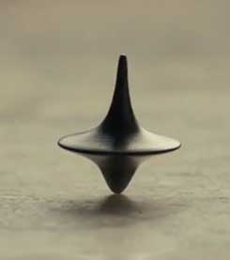
Protecting Your Accounts from Unauthorized Resets
Keep contact information up to date on accounts.
Make security questions hard to guess but easy to answer.
  Examples
    Always make the answers as if you were your mother.
    Always make the answers with a beginning special character.
    Always spell the answers backwards.
    This information can be stored in a password manager as well.
Notes:
I work in a small town. As a fun show of hands experiment, I like to ask how many of them were born here, went to school in this town, or met their spouse in this town. After most of their hands are up, I like to also ask how many have a security question asking where you were born, went to school, or met your spouse.

Slide 12
Detecting spam and phishing emails
Is the email from a legitimate source?
Does the email address match the sender?
Does the email sound legitimate?
Are attachments expected and legitimate?
Do links go to a legitimate location?
  Be careful of shortened URLs.
Never send a password through email.
When in doubt, delete.
Notes:
This whole slide can be boiled down to the word legitimate.
The attachments part is a great place to talk about malware.

Slide 13
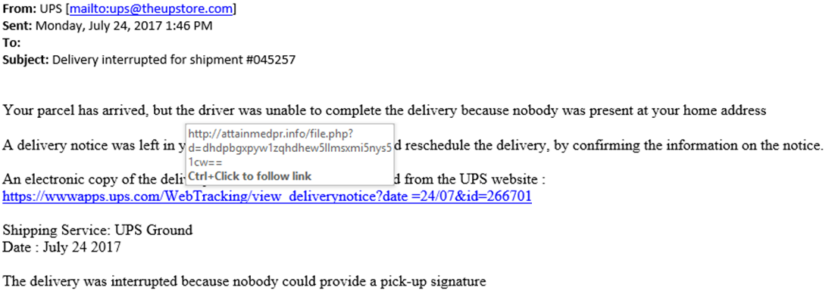
A Perfect Phishing Example
Notes:
Note that the email address is not theUPSstore.com but rather theUPstore.com
Note that the URL is not redirected to UPS.com.

Slide 14
Phishing Websites
Designed to imitate a legitimate website so that you provide your account information.
Link to phishing website is often provided in a phishing email.
Usually paired with a sense of urgency.
  Something like “Enter your password to prevent account deletion.”
Check for trash before the slash
  https://email.YOURWEBSITE.fakewebsite.com/passwordreset
  https://email.YOURWEBSITE/passwordreset

Slide 15
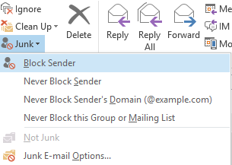
Cutting Out Spam
Rarely give out your email address.
Generate single use email addresses when an email address is required temporarily: https://www.mailinator.com/
Use that unsubscribe button for legitimate websites.
Use the Junk – Block Sender buttons in Outlook.
Notes:
I prefer calling single use email addresses burner email addresses instead. It makes me feel like a spy.

Slide 16
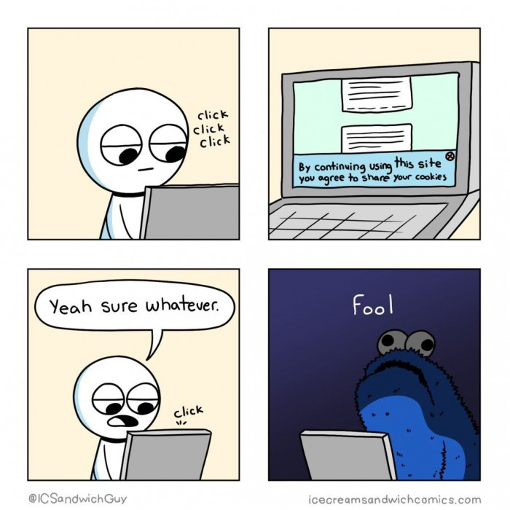
Internet Ads – Annoying and Dangerous
Malvertising: using online Ads to spread malware
Prevent by using an ad block extension in your browser.
  For example, uBlock Origin in Chrome.
  Works by blocking certain elements on a website.
  May need to occasionally disable blocker if it breaks a website.
Notes:
Nothing like a good comic to teach security.

Slide 17
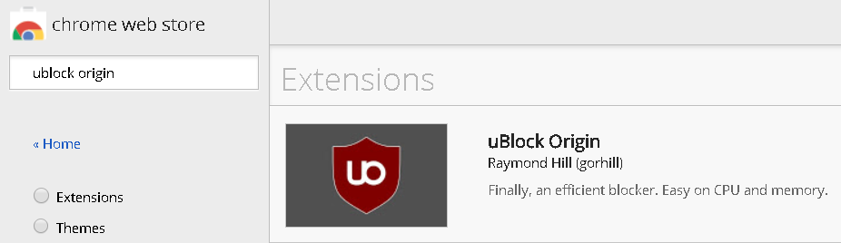
Installing uBlock Origin
Open Google Chrome
Browse to: chrome://extensions/
Scroll to the bottom and click on Get More Extensions
On the left, search for ublock origin and add it to Chrome.
Notes:
If you can, find a legitimate website with a lot of ads. Show the before/after view of the website. Nytimes.com and WSJ.com both make good examples.

Slide 18
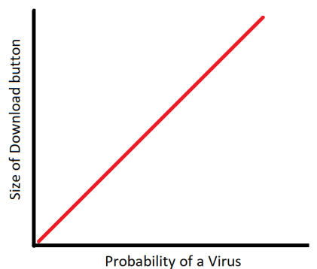
How to not install a virus
Only download/install from trusted locations.
Read message and warning prompts.
Keep software updated.
Notes:
Remind them of the guy who shared his cookies because he didn’t read the warning prompt.
I would have liked to jump a lot more into least privledged access (why you are not an administrator and neither am I). It was cut because of time constraints.

