Slide 1
Managing Your Files

Slide 2
What are quotas?
Each staff member is given 2GB for the U, P, and S drives and ½ GB for the H drive.
Any file saved on the U, P or S drive take away from the 2 GB total.

Slide 3
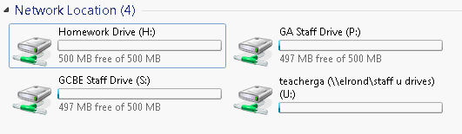
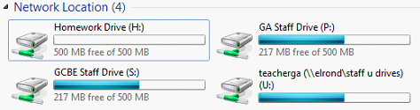
An Example
In the picture below, notice how all four drives are nearly empty.
Now we will save a bunch of files to our Documents (which are in the U drive). Notice how the U, P, and S drives are now equally full

Slide 4
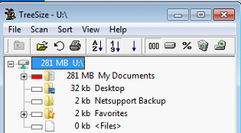
How to clean up your U drive?
Click Start – then Computer. Right click on your U drive and select TreeSize. If prompted, press OK.
After TreeSize has finished scanning, you will see a graphical view of your files. In the picture below, I have 281 MBs in My Documents.

Slide 5
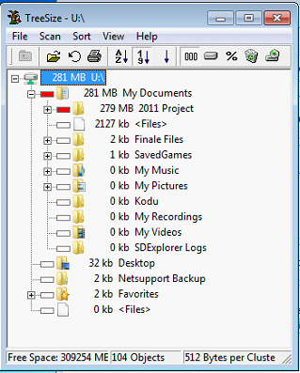
How to clean up your U drive?
Pressing the + button next to a folder will reveal the contents. While I have 281 MB in Documents, most of that space is in a folder named 2011 Project.
Because I no longer need that folder, I can right click on it and select Delete

Slide 6

Deleting Your Files from the P Drive
Open up the P Drive. In the top right, type Owner:PIN NUMBER and then press enter.
This search may take a few minutes. After the search completes, you can delete any unneeded file.

