Slide 1
Setting up Microsoft SkyDrive

Slide 2
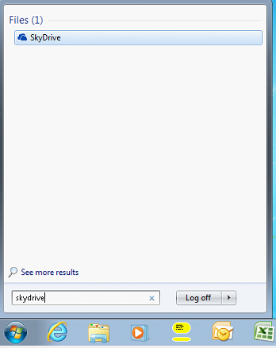
Step 1
Go to start and type SkyDrive in the Search Bar
If you do not see SkyDrive, restart once.

Slide 3
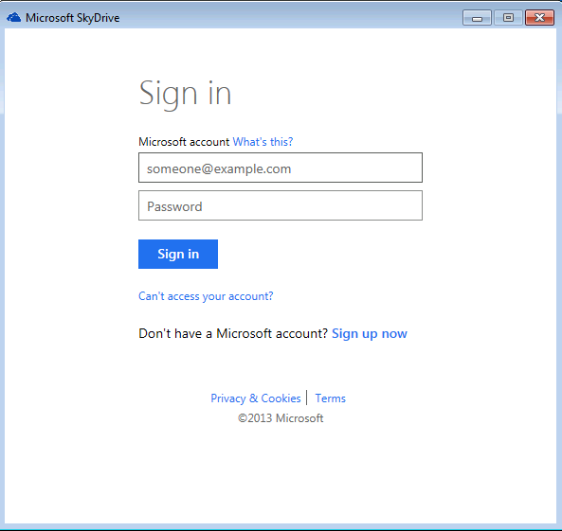
Step 2
Select Get Started.
On the Sign in page, enter your Microsoft Username and Password.
If you do not have an account, you can sign up for one by clicking “Sign up now”.

Slide 4
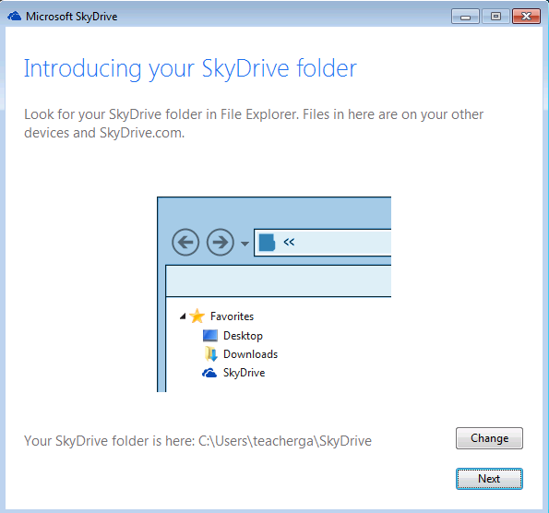
Step 3
SkyDrive will place a shortcut in your Explorer Favorites.
On the Introducing your SkyDrive page, select next.

Slide 5
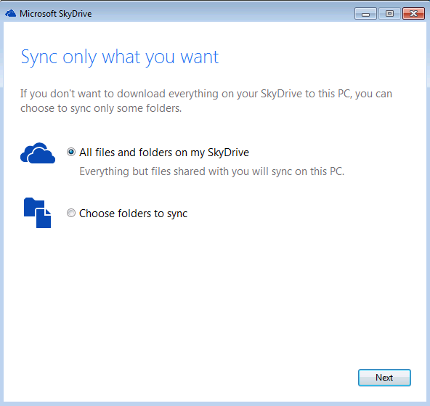
Step 4
SkyDrive allows for you to selectively sync certain folders.
Most of the time, syncing all files and folders will be the best choice though.
Select Choose folders to sync to exclude any pre-created folder.

Slide 6
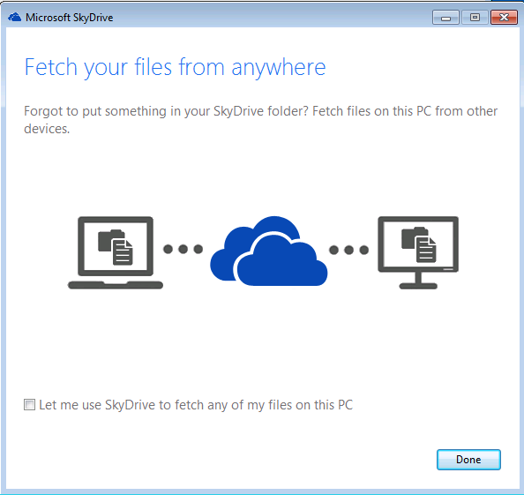
Step 5
Uncheck “Let me use SkyDrive to fetch…” and then press done.

Slide 7
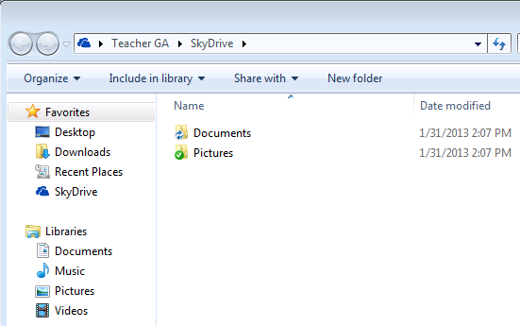
Step 6
SkyDrive is now installed! It can be accessed by opening your Documents or Computer.
Now, you can copy/paste or drag and drop files into or out of your SkyDrive.

