Slide 1
Extracting MSIs for Software Deployment
Joseph Moody, DeployHappiness.com

Slide 2
Ground Rule
This isn’t stump the chump – I won’t be able to answer every question
  Especially specific questions like “where is the MSI for Adobe Flash 8.600.1.423?”

Slide 3
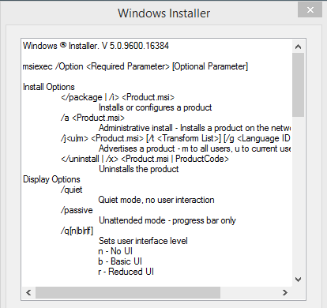
Why Should I Even Care?
MSIs are the easiest application type to install
MSIs are self repairing
MSIs (mostly) have clean uninstalls
MSIs let you layer software changes through transforms
MSIs have standard switches and features
  /q will always be quiet
  /x will always uninstall
  /t will always apply your transform
In an ideal environment, you would deploy 100% MSIs using GPSI or SCCM.

Slide 4
Hardest Part is Getting the MSI
My Order of Operations for MSI Usage:
  Company Provided MSI
  Extracted MSI from Application
  Repackaged MSI
  3rd Party Provided MSI (hosted on another site, repackaged by someone else)
Today – we will focus on #2 by extracting MSIs from an EXE

Slide 5
Why Not AppDeploy It?
AppDeploy (now ITNinja) is a great resource – I use it all of the time to quickly find application settings.
But AppDeploy :
  Doesn’t teach you how to actually work with software
  Might not have the application listed when you really need it! (think unique apps)
Would you rather rely on someone else to post their findings or rely on your skills?

Slide 6
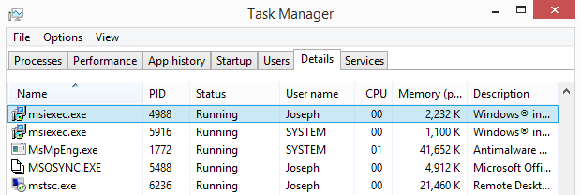
How do we know an MSI is even there? Clue #1
When launching the setup, you should at least see MSIEXEC under Task Manager
MSIs are driven by MSIEXEC
Process should be running as you.

Slide 7
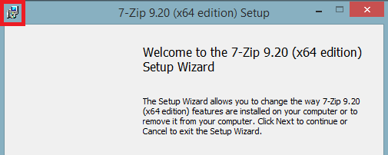
How do we know an MSI is even there? Clue #2
The MSIEXEC icon can be found on/within the setup.
You see the MSIEXEC icon during the extracting/setup phase of the install

Slide 8
Where, oh where, did my MSI go?
Companies aren’t the best about storing the MSI in a standard location:
Here are some possible locations:
  %TEMP%\; C:\windows\temp\ EX: Shoretel Communicator, VMWare Products
  %USERPROFILE%\AppData\Local\Temp\ EX: A lot of Microsoft Products!
  %APPDATA%\; Appdata\Roaming EX: Java
  C:\Windows\Installer\ <only true if MSI has already been installed on machine
Be sure that hidden files are visible and that file extensions are visible.
Narrow your search to just MSIs by searching for *.MSI
If you redirect %APPDATA%, be sure to check the network location instead of a local folder

Slide 9
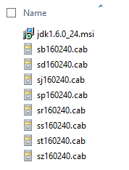
Don’t Forget the CABs, .INIs, or Other Files!
When searching, always copy the entire folder that the MSI is in. An MSI doesn’t want to be without its cronies.
If the MSI has multiple components (such as a dependency), be sure to grab those files and to maintain their folder structure.
For example, copy .\JAVA\JRE\* instead of just .\JAVA\JRE\installer.msi

Slide 10
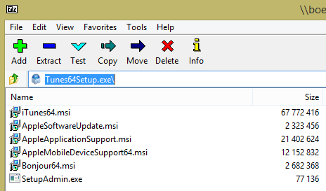
7-Zip for Extraction
7-Zip is one of my favorite MSI finding tools!
I tend to take this step first – it shows me what is going on.
Once you have your setup, right click and select 7-Zip/Open Archive.

Slide 11
Advanced Installer and InstallShield
For executables made with Advanced Installer:
  Setup.exe /x or Setup.exe /extract
For executables made with InstallShield:
  Setup.exe /b or Setup.exe /extract_all
If the EXE will pass switches to the MSI, you can use:
  Setup.exe /a /s /v”/qb” TARGETDIR=“C:\Users\Public\Extract\”
If all else fails, use setup.exe /? or setup.exe -?

Slide 12
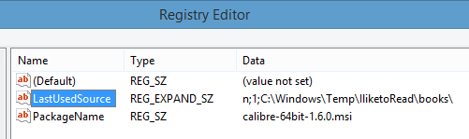
Check the Registry
After installation, MSIs should register at: HKEY_LOCAL_MACHINE\SOFTWARE\Classes\Installer\Products
Search for your product and expand SourceList
If the MSI doesn’t exist in the LastUsedSource location anymore, relaunch the installer and check it again.

Slide 13
Log Files
Some EXEs will generate log files that list the MSI location. Problem is finding the log files.
Possible Locations:
  The install root (installer location)
  Program Files\ApplicationName\
  %Temp%

Slide 14
What’s Changed?
As a last resort, you can use a before/after snapshot to track computer changes.
My current favorite is What’s Changed.
Steps:
  Before Snapshot
  Launch application and leave at first prompt
  After Snapshot, open log file for MSI location

Slide 15
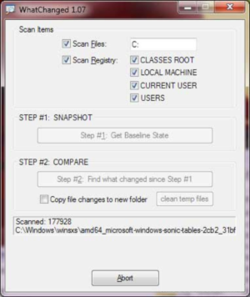
What’s Changed: Tips
Only scan files – select just the primary drive.
If MSI isn’t found in the After Snapshot, repeat the process and install the software.

Slide 16
Final Tips
Use a VM with snapshots to find extract, configure, and test your applications.
Base this VM off of your most common machine configuration.
Pre-setup the following applications on your VM:
  7-Zip
  Trace32
  Process Monitor
  PSTools
  What’s Changed

