Slide 1
PowerShell 3.0
Joseph Moody
DeployHappiness.com

Slide 2
Introduction
Goal is to have regular Lunch & Learn sessions
  Short Trainings
  Networking
  Motivation
If you have an idea for a future session (or want to lead one), send me an email at: joseph@deployhappiness.com
If you don’t have a laptop, go ahead and pair up with someone.
Notes:
First – thank you for coming!
Second- a big thank you to the college for letting us use their facilities

Slide 3

What is PowerShell?
Microsoft’s primary scripting language
Introduced in 2006
Now in version 3 (released 2012)
PowerShell can run on Windows XP and above
Integrated into all new management consoles
PowerShell is so powerful because of built-in cmdlets (2000+)

Slide 4
CMD vs. Scripts
CMD:
  Quick to run
  Native support
  Isolated bubbles
  Nonstandard parameters
  Little automation
  Little customization
Scripts
  Great for automation
  Native support
  More customization
  Isolated bubbles
  Nonstandard parameters
  More complex

Slide 5
Why Learn PowerShell?
Combines best of CMD and best of Scripting
  Standard Parameters (ex: -computername across all cmdlets)
  Native Support, Quick to Run, and More Customization
  Non-Isolated
Automate a huge number of common tasks with built in commands
Because it is a critical skill
Notes:
Being able to comfortably use PowerShell is as necessary as knowing how to map a drive, share a folder, or creating user

Slide 6
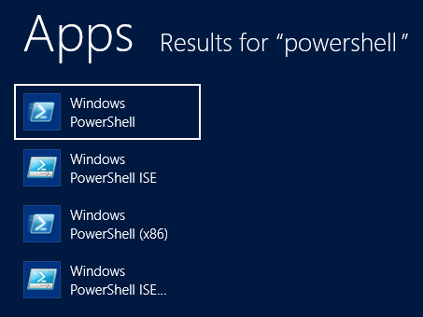
X86 or X64?
If you are running a 64-bit OS, you actually have four PowerShell options:
Whenever possible, run the X64 version. Large scripts that run synchronous will get a great performance boost. You will also have less issues running between
Notes:
And if you are still running a 32bit OS, you should look into 64 bit.

Slide 7
Console vs. ISE
PowerShell comes in two versions: Console and Integrated Scripting Environment (ISE)
Console is very similar to the Command Prompt, very fast, and runs on any modern Microsoft OS (including Server Core).
Console is about as user friendly as the Command Prompt and has nonstandard hotkeys
ISE has a combination of a scripting pane and command window.
ISE is user friendly and scalable for novices and experts but can’t run on Server Core.
Notes:
Overall, I prefer ISE. I only use console for prewritten scripts where I want near immediate access.

Slide 8
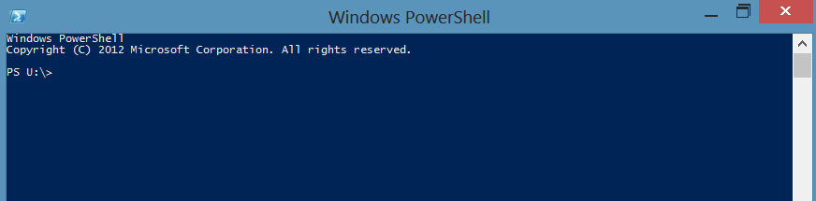
PowerShell Console
Go ahead and open the Powershell Console
Notes:
If you ever open the console and want to jump to ISE, just type ise and press enter

Slide 9
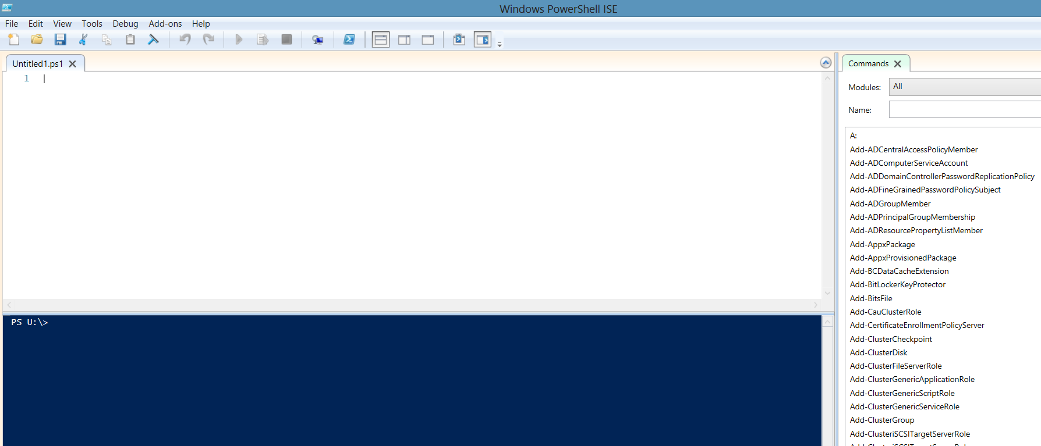
PowerShell ISE
Command Explorer
Script Editor
Command Window
Notes:
If you haven’t, go ahead and launch PowerShell ISE by entering ISE at the console

Slide 10
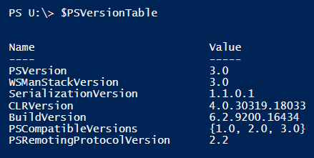
PowerShell Versions
  What version do I have?
    In the command window, type $PSVersionTable
  How can I get 3.0?
    Running Windows 8/Server 2012: You already have it.
    Running Windows 7/Server 2008 R2: Download Windows Management Framework 3.0
  Bonus: Although Windows Vista can’t run 3.0, Server 2008 can!
Notes:
Anything in Bold and Blue are commands that I want you to type along with me.

Slide 11
Command(lets)
What is a cmdlet?
  A prewritten script simplified into a command with parameters. EX: Test-Connection
  Test-Connection = PING except PING is isolated
Always Verb-Noun: Get-Command, New-ADUser, Test-Connection
Commands have parameters (options):
Test-Connection –ComputerName localhost
To see a list of all commands: Get-Command
Notes:
With Test-Connection, I can do things like: “ping” a computer, restart, and RDP when it becomes live again.

Slide 12
Aliases
Aliases are shortcuts for commands: designed for speed and ease of use for previous languages
  Question: How could you list all of the files in folder when in the command prompt?
  Answer: DIR
  Question: How could you list all of the files in folder when in PowerShell?
  Answer: DIR
DIR is an alias for Get-ChildItem
To list all aliases, type Get-Alias

Slide 13
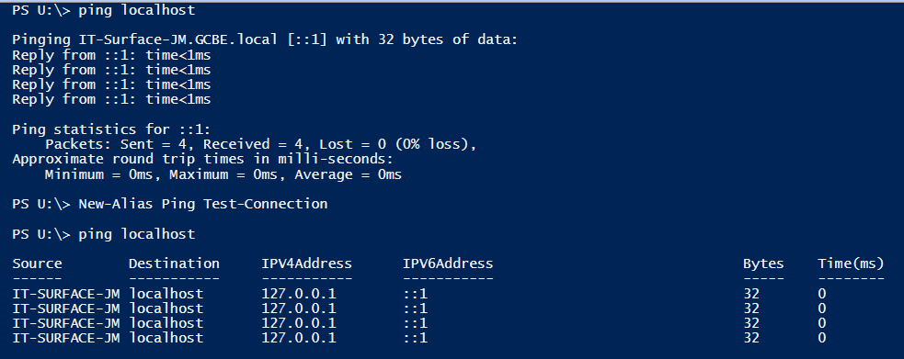
Creating an Alias
Can anyone guess how to create a NEW ALIAS?

Slide 14
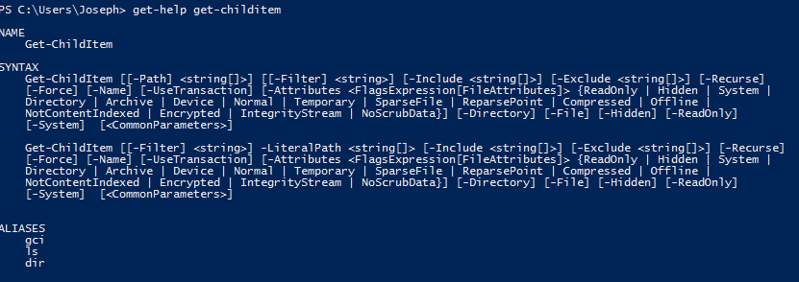
Help!
Your Google for PowerShell: Get-Help
  Get-Help Get-ChildItem
  Get-Help Get-Childitem –examples
  Get-Help Get-Childitem –full
  Get-Help Get-Childitem –online

Slide 15
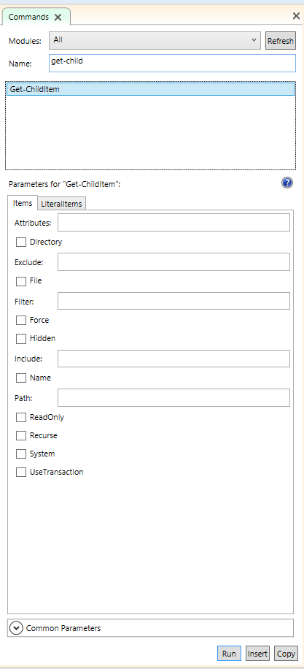
More Help!
PowerShell 3 Command Pane is an excellent for GUI based help.
  Search/Filter for that one command you need
  Visually see syntax, parameters, requirements
  Easily insert code
  Launch Help

Slide 16
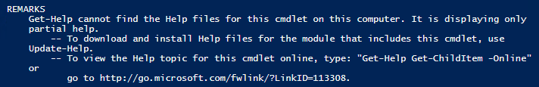
New Help!
PowerShell is constantly changing with new features and updated cmdlets. In fact, PowerShell 3 comes with a limited help file built in.
Make a habit (or better yet – a scheduled task) to update your Help files. Be sure to run command below from an Administrative PowerShell.
Update-Help

Slide 17

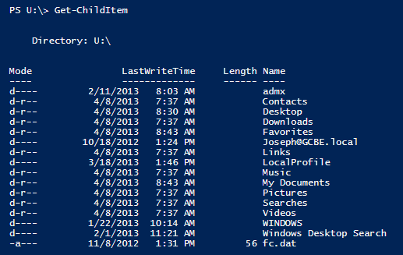
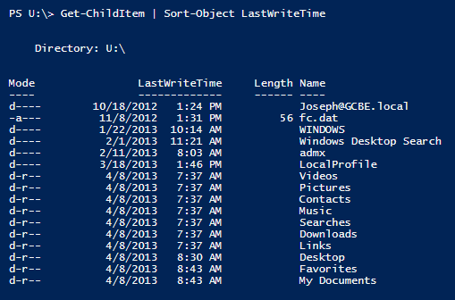
Piping
Allows you to take individual commands and combine their functions. Extremely powerful by breaking up command bubbles!
The pipe character (|) is shift + backslash (\)
Notice how Get-ChildItem sorts by name.
Now we are sorted by the Last Write Time

Slide 18
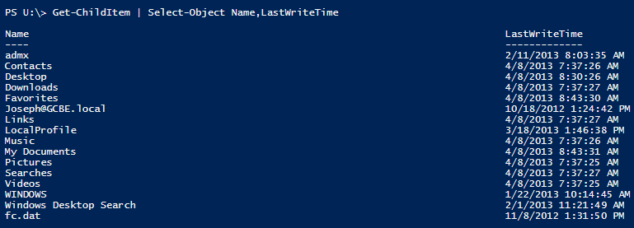
What can I pipe and what can I see?
When we ran Get-Childitem, we were given four columns (properties): Mode, LastWriteTime, Length, Name
What if you wanted to run Get-Childitem and only wanted to see the name and LastWritetime properties:
Notes:
Well, pretty much everything! The trick is finding what you want to feed and discovering where it needs to go.

Slide 19
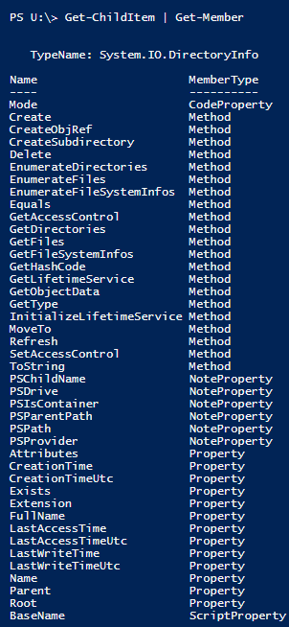
What can I pipe and what can I see?
What if you wanted to run Get-Childitem and only wanted to see the name and the date the file was created? Use the Get-Member command
Get-ChildItem | Get-Member
Get-ChildItem |
Select-Object Name,CreationTime

Slide 20
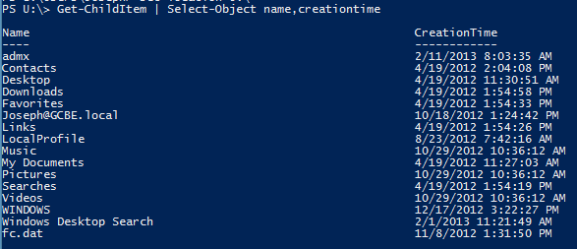
What can I pipe and what can I see?
Get-ChildItem | Select-Object Name,CreationTime

Slide 21
Going Further
Still want to learn more?
  Subscribe to these three blogs:
    Hey, Scripting Guy!
    Power Tips
    PowerShell Pro
    http://deployhappiness.com/resources/complete-rss-feed-list/
  Read these two books:
    Learn Windows PowerShell 3 in a Month of Lunches
    Windows PowerShell 3.0 Step by Step
    http://deployhappiness.com/resources/top-books/

Slide 22
Your Goals
  Constantly practice – when you have a spare moment and a repetitive task, script it! Yes it will be frustrating and take much longer than manually doing it. But you will learn so much!
Make these two scripting goals:
  Automate a task you do everyday:
    Creating computers, users, assigning permissions, adding to groups, etc
  Automate a task you should do regularly (but don’t):
    Deleting stale computers/users, setting accidental deletion, backing up GPOs, etc
Post your two goals (and scripts) here:
  http://deployhappiness.com/community/lunch-and-learn-powershell-3/
Notes:
No one wants sit around writing scripts that have no purpose. Take time to automate a process. You will enjoy it (and get more time to automate more processes).

